Slide 1
Algorithms
Lecture 8
Shortest Path Algos (Dijkstra, Bellman-Ford)
Prantik Paul [PNP]
Lecturer
Department of Computer Science and Engineering
BRAC University
Adapted From: Slides by Dr. Md Abul Kashem Mia, CSE, BUET

Slide 2
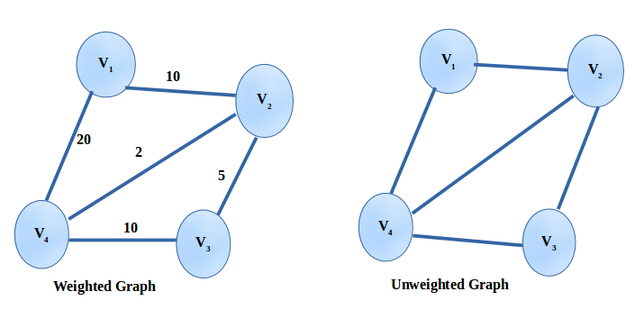
Weighted Graph

Slide 3
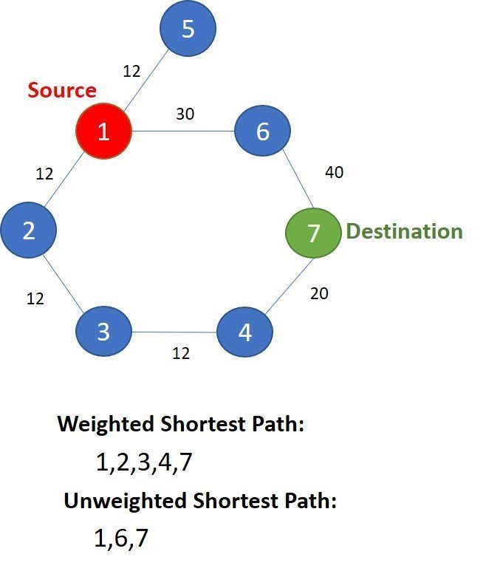
Weighted Graph and Shortest Path

Slide 4
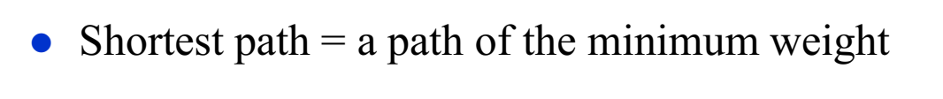
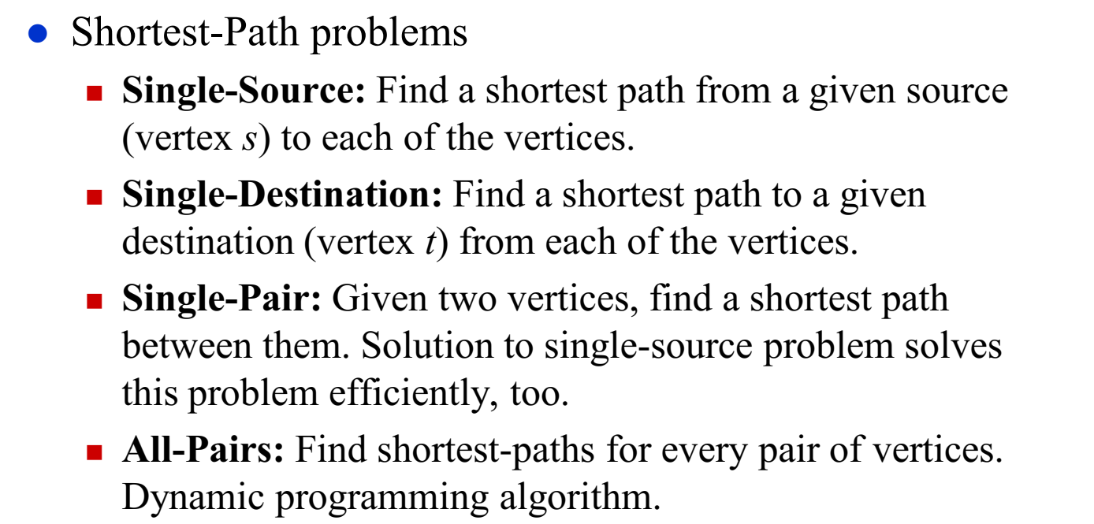
Shortest Path Problem

Slide 5
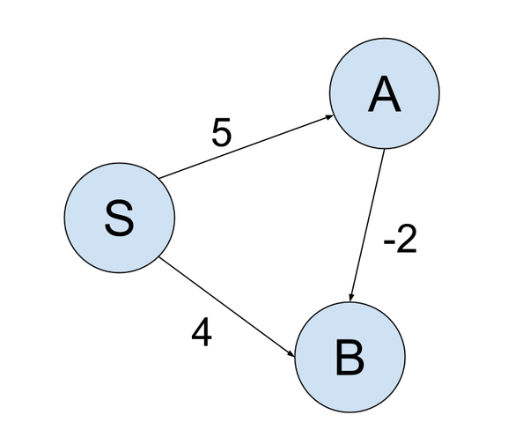
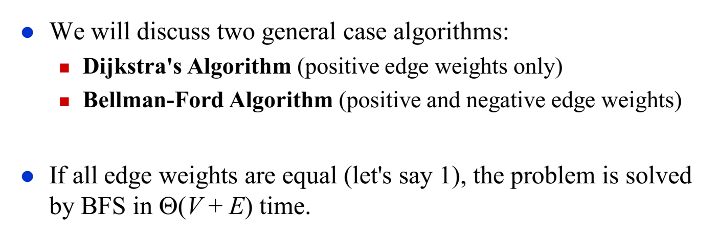
Single-Source Shortest Path Problem

Slide 6
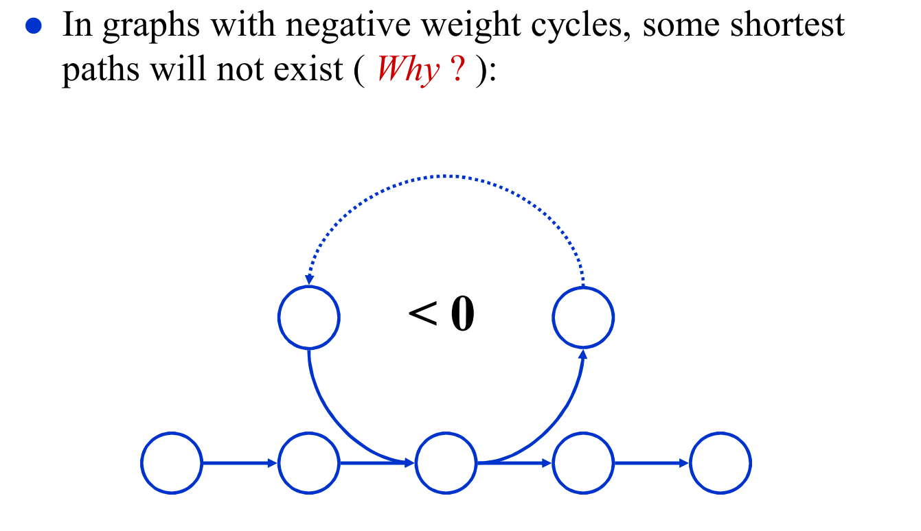
Negative Weight Cycle
If there is a cycle for which the total weight is negative, then Bellman Ford cannot find the shortest path.

Slide 7
Negative Weight Cycle
Suppose the graph has vertices like these
3
-6
2
S
T
1
3

Slide 8
Negative Weight Cycle
path | distance
1 | 4
Suppose the graph has more vertices like these
3
-6
2
S
T
1
1
3
Distance = 1+3 =4

Slide 9
Negative Weight Cycle
path | distance
1 | 4
2 | 3
Suppose the graph has more vertices like these
3
-6
2
S
T
1
1
3
Distance = 1-6+3+2+3 = 3

Slide 10
Negative Weight Cycle
path | distance
1 | 4
2 | 3
3 | 2
Suppose the graph has more vertices like these
3
-6
2
S
T
1
1
3
Will keep going reducing the distance, therefore shortest path cannot be found
Distance = 1-6+3+2-6+3+2+3 = 2

Slide 11
Negative Weight Cycle
Suppose the graph has more vertices like these
There is a cycle here and for this cycle the total weight is
3 + 2 - 6 = -1. Since the total weight is negative, it will form a negative weight cycle and there will be no shortest path.
3
-6
2
S
T
1
3

Slide 12
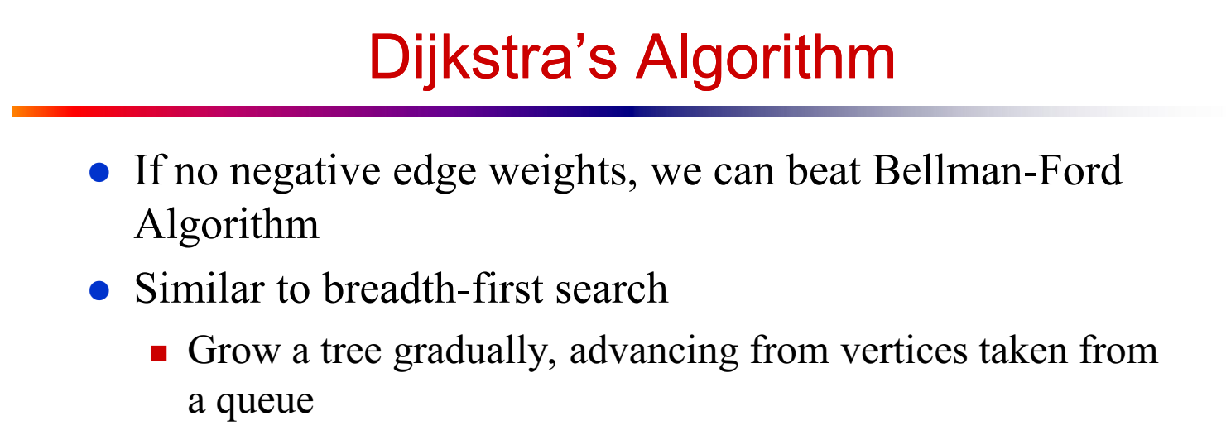

Slide 13
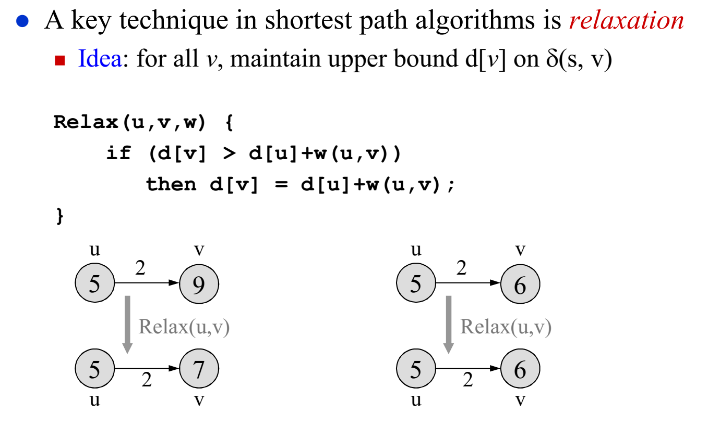
Relaxation
<Distance from source>
5+2 = 7 > 6
So, do not update
5+2 = 7 < 9
Update distance
of v to 7 from 9

Slide 14
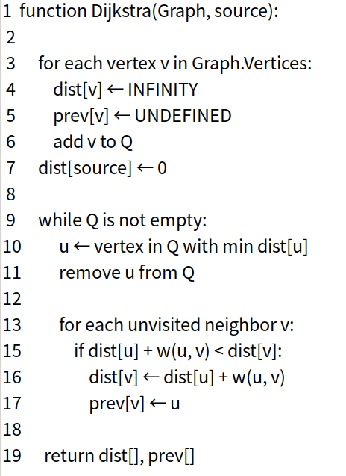
Dijkstra Algorithm Pseudocode
Very similar to BFS
Instead of regular Queue, we use Min Heap
Relaxation

Slide 15
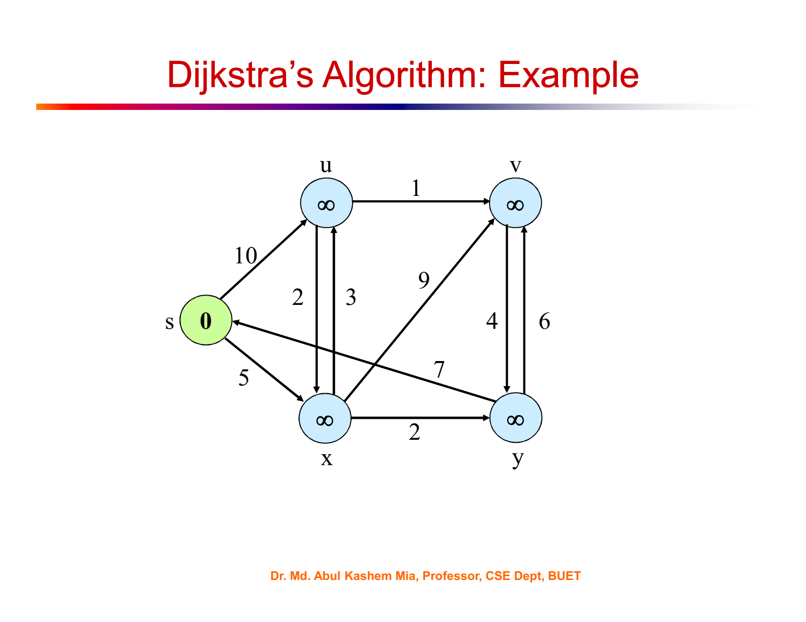

Slide 16
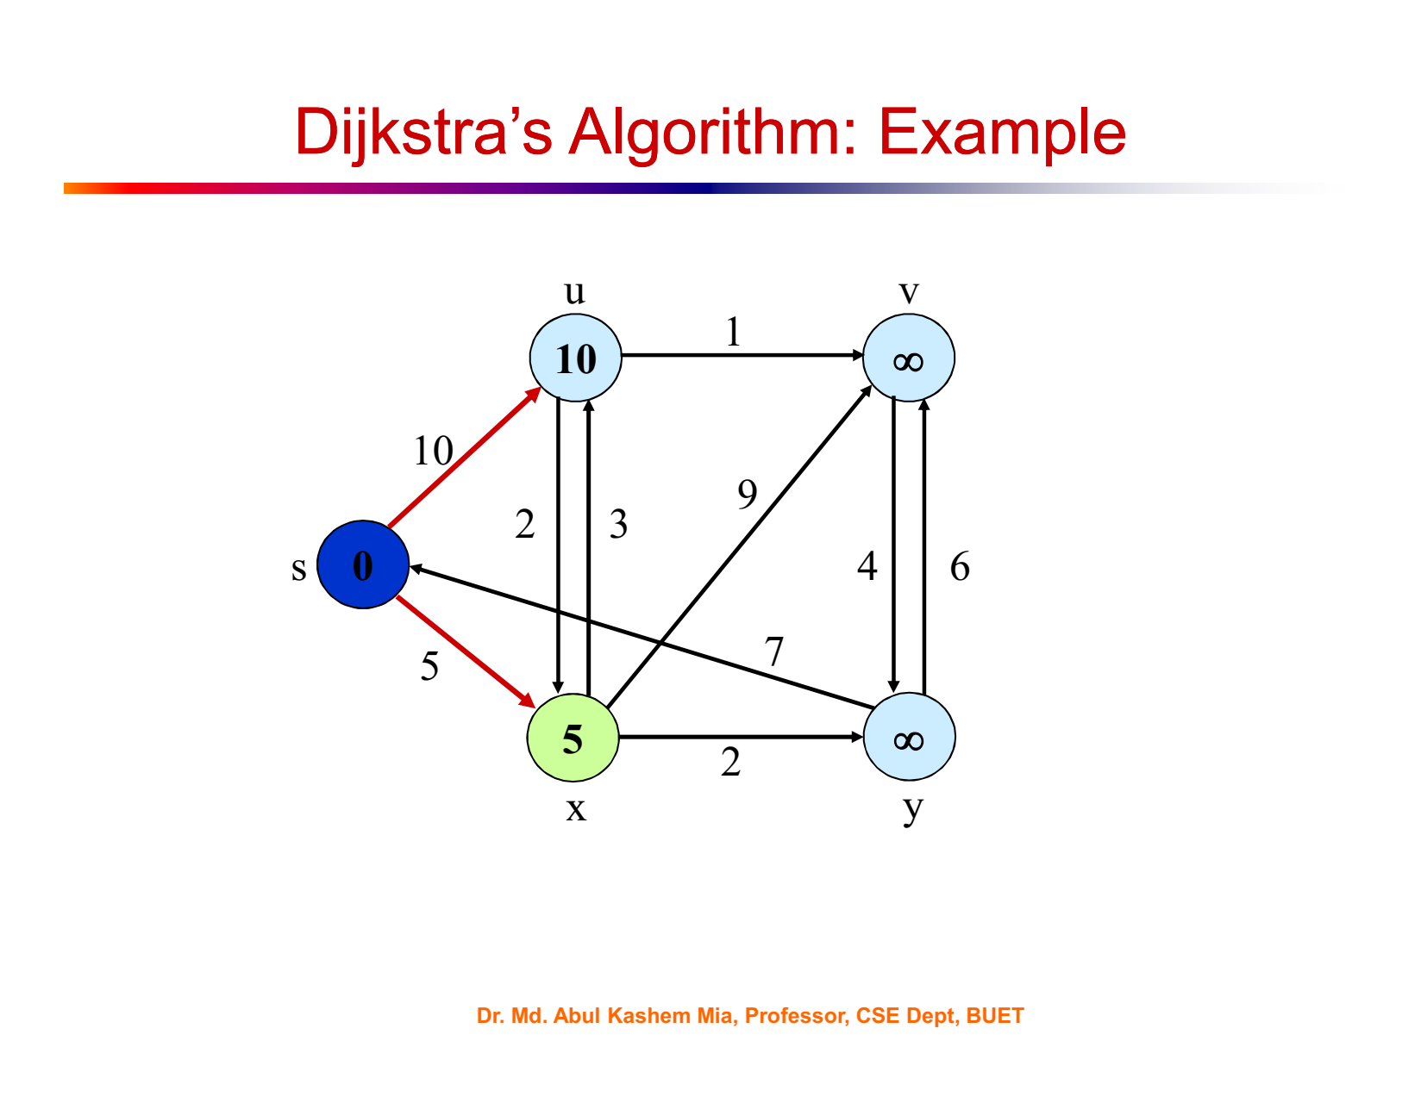

Slide 17
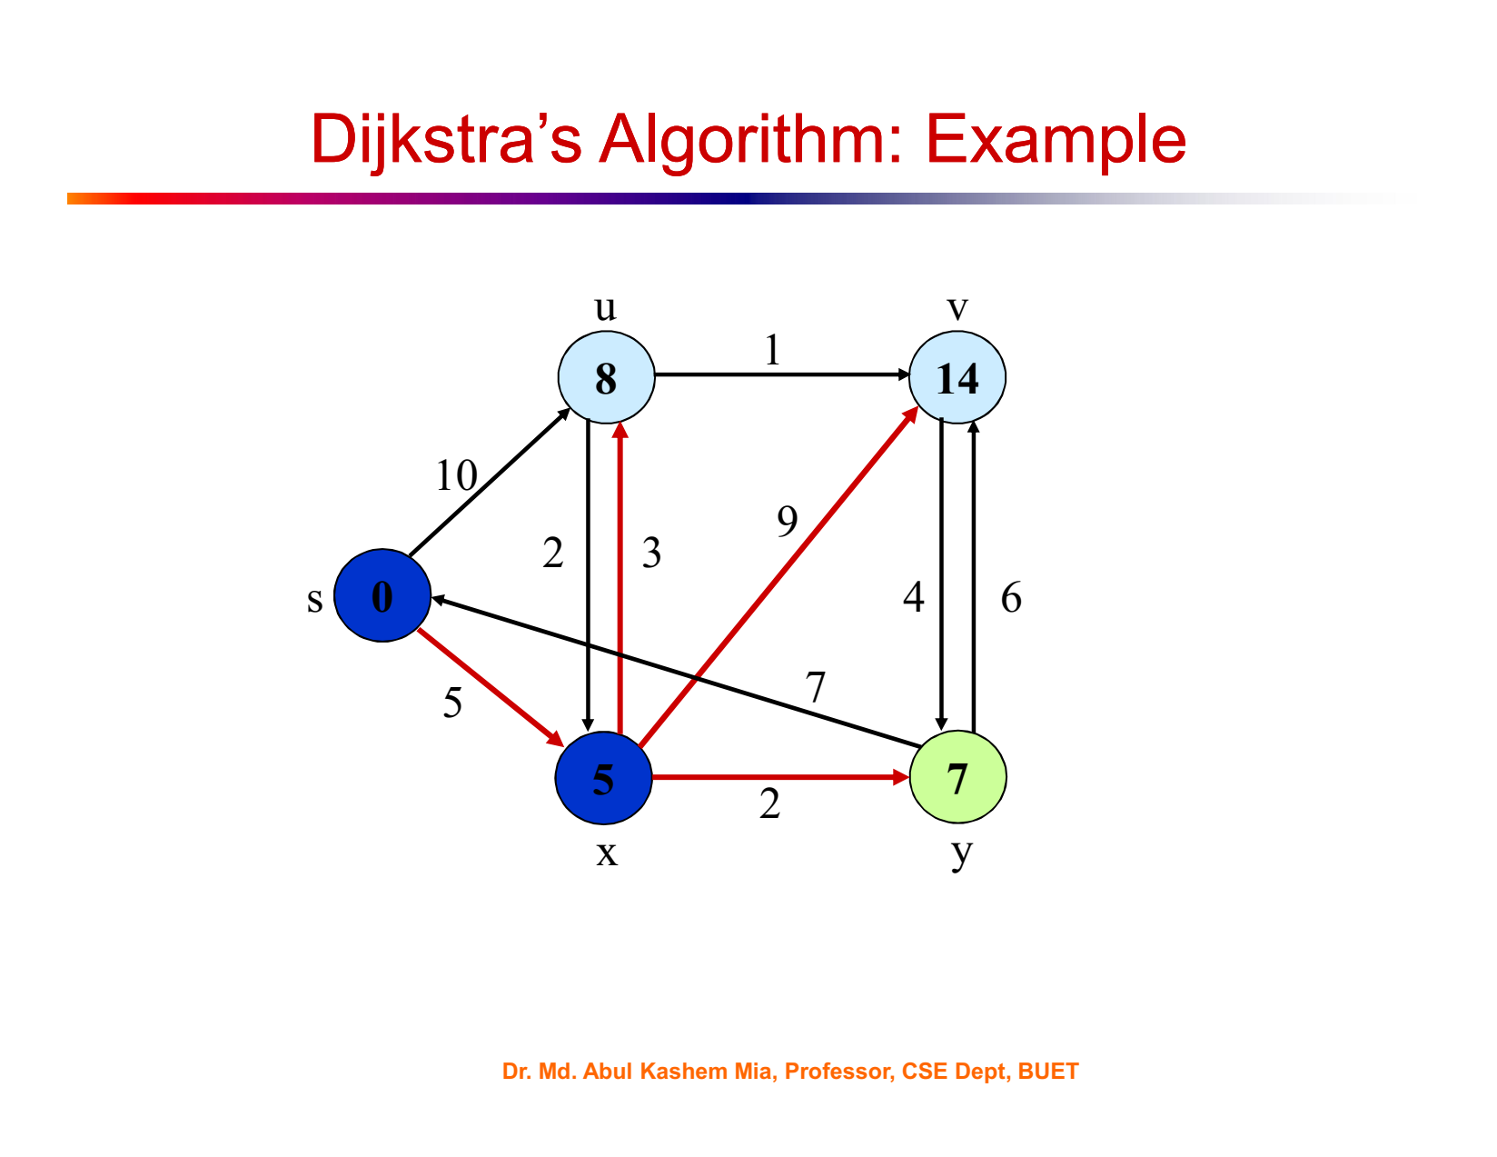

Slide 18
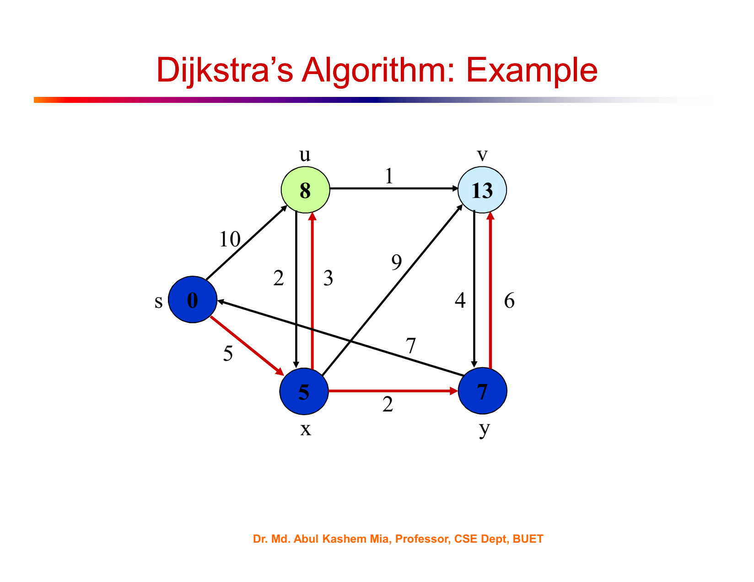

Slide 19
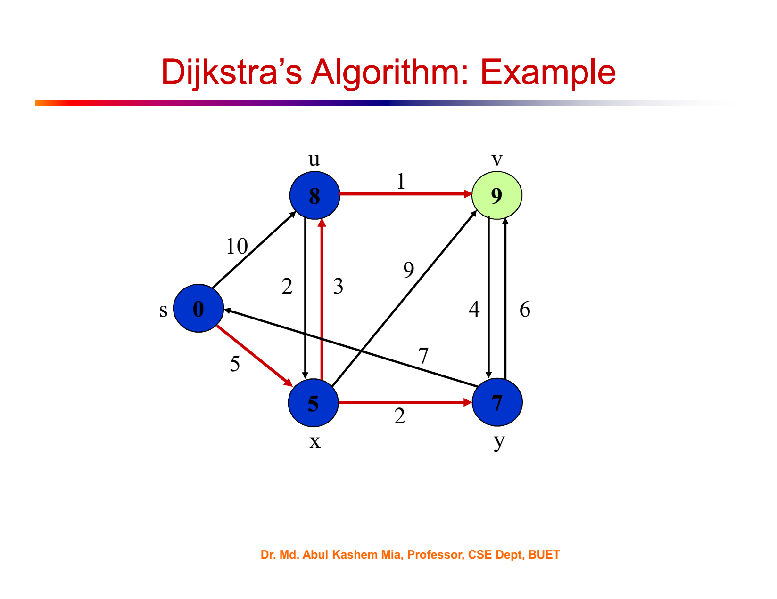

Slide 20
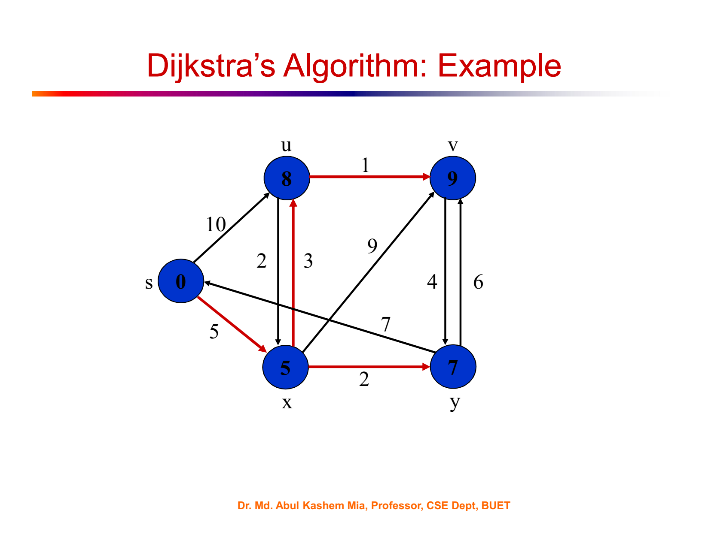

Slide 21
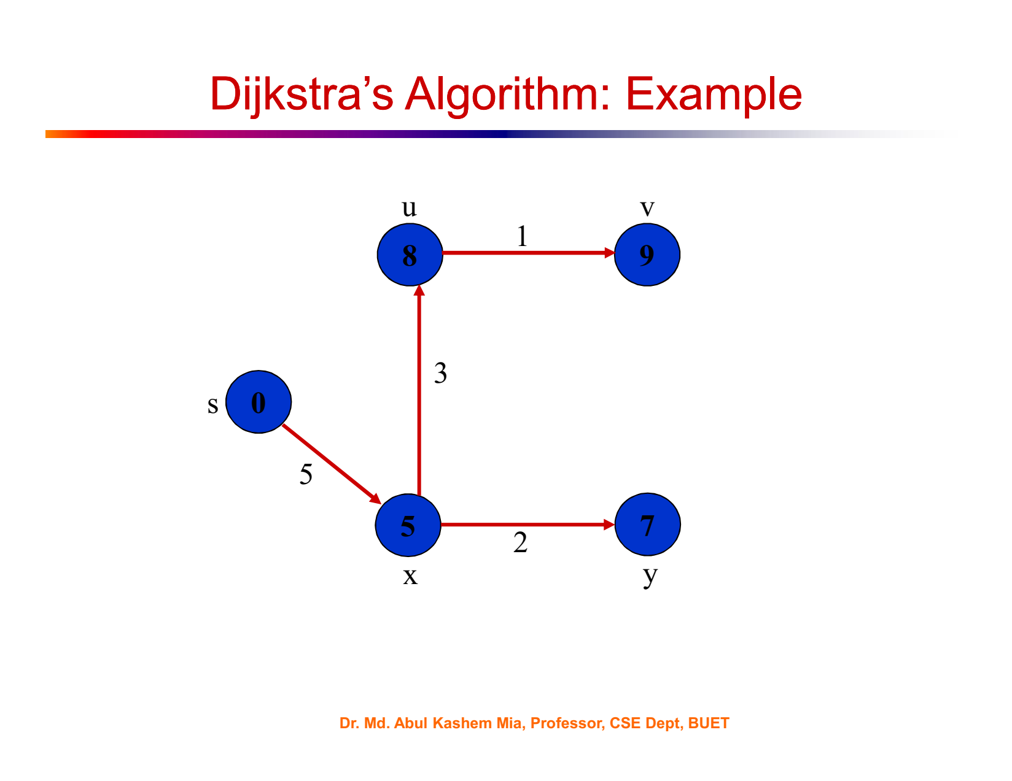

Slide 22
Dijkstra Algorithm Pseudocode
Very similar to BFS
Instead of regular Queue, we use Min Heap
Relaxation

Slide 23
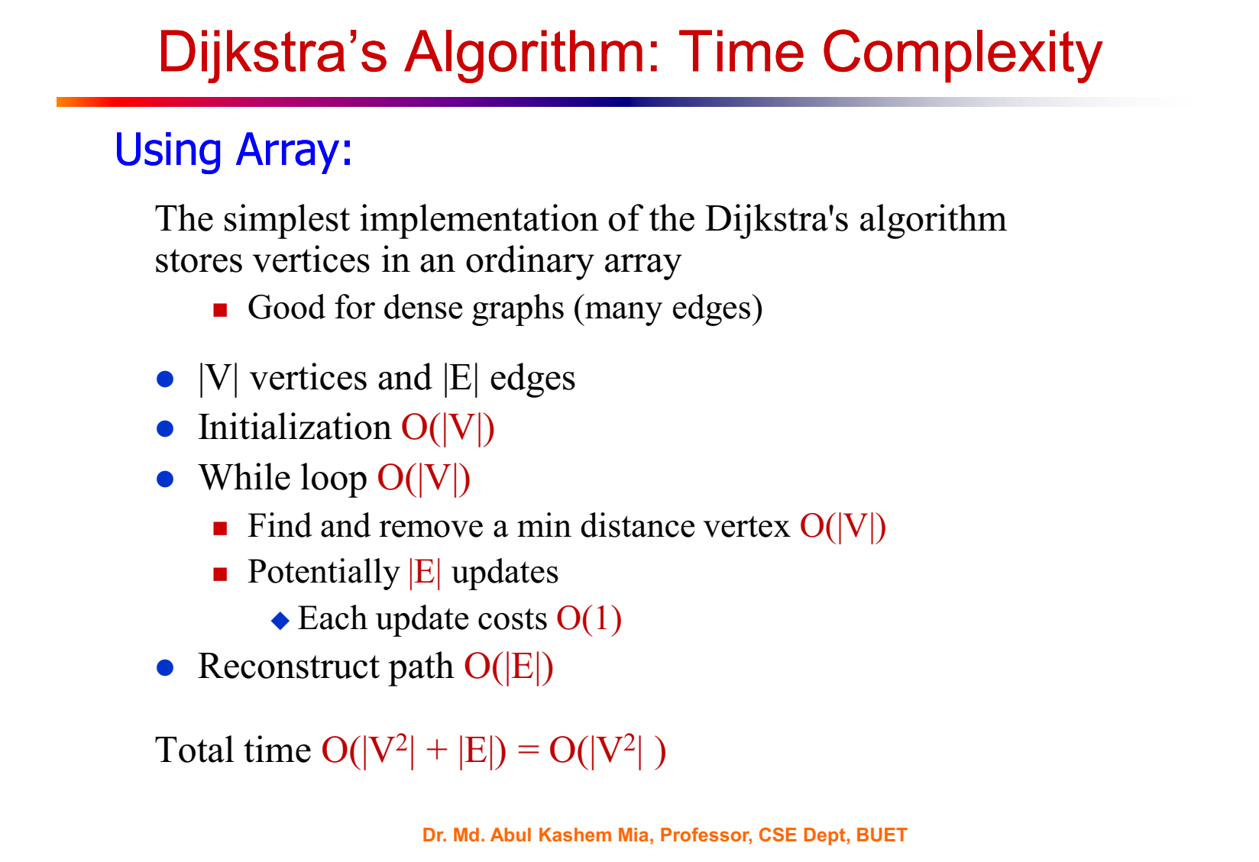

Slide 24
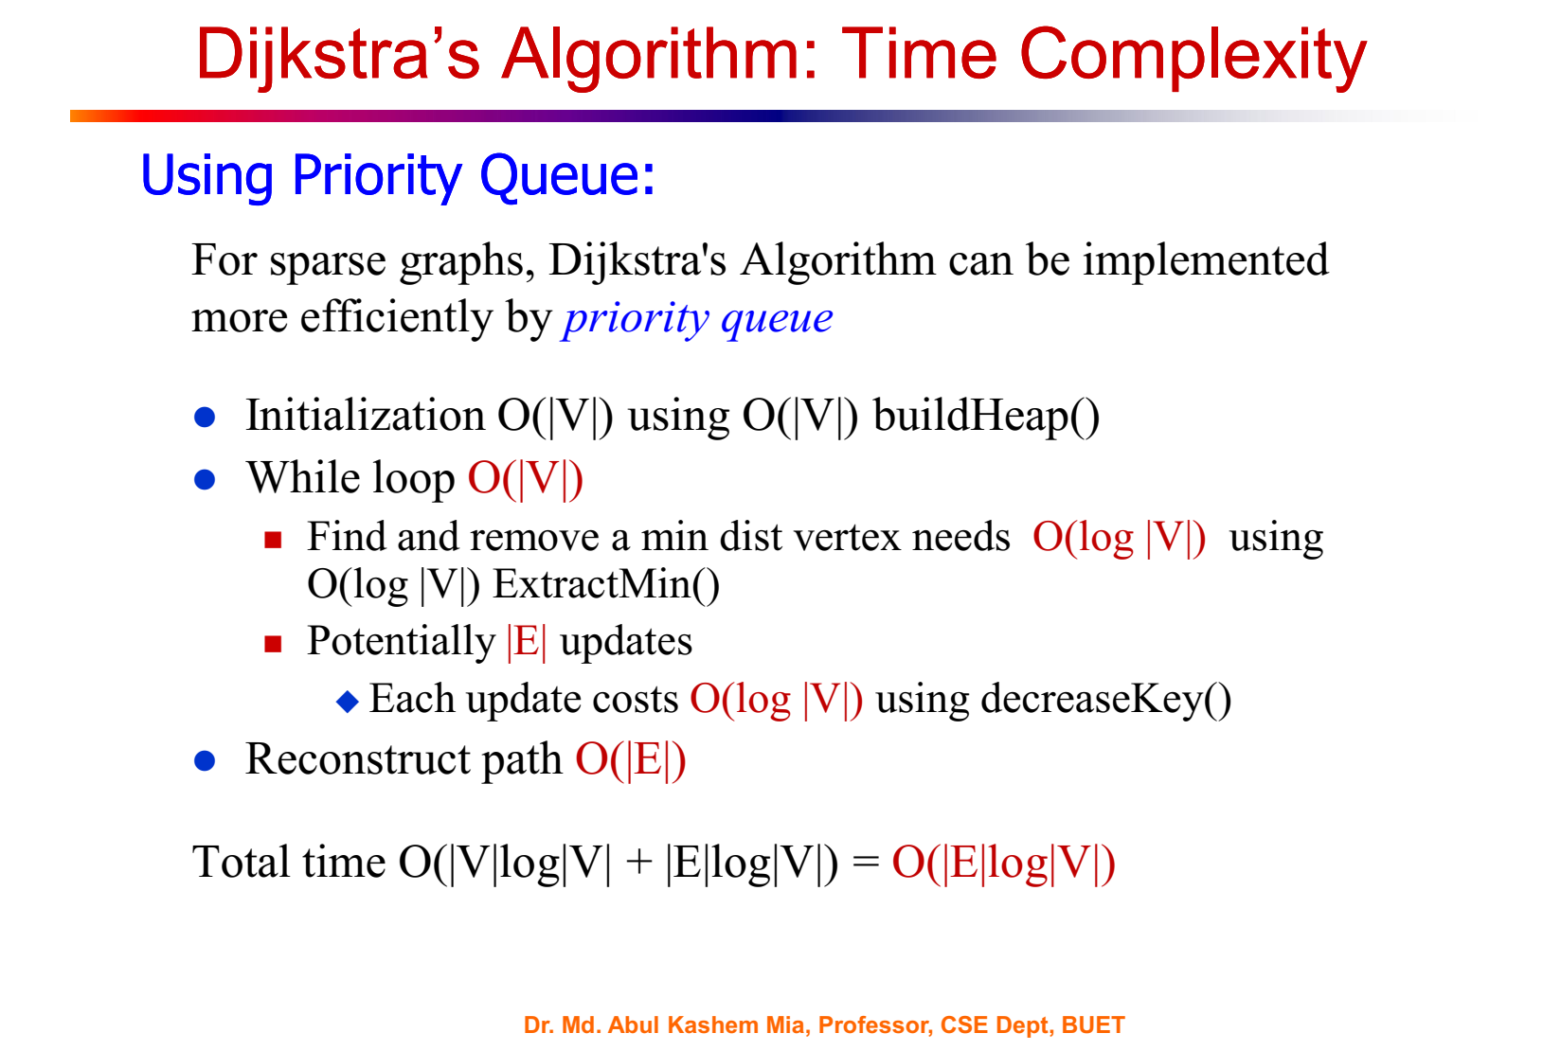

Slide 25
Example usage of Dijkstra's algorithm:
graph = {
'A': {'B': 1, 'C': 4},
'B': {'A': 1, 'C': 2, 'D': 5},
'C': {'A': 4, 'B': 2, 'D': 1},
'D': {'B': 5, 'C': 1}
}
start_vertex = 'A'
result = dijkstra(graph, start_vertex)
print(result)
# Output: {'A': 0, 'B': 1, 'C': 3, 'D': 4}

Slide 26
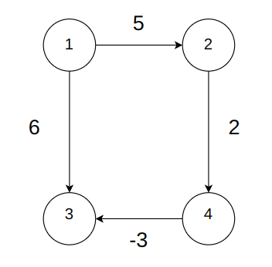
Limitation of Dijkstra
Might fail to find minimum distance in case of negative weights.
Example:

Slide 27
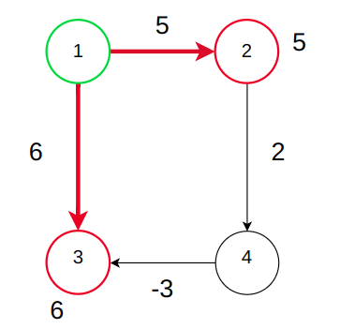
Limitation of Dijkstra
Might fail to find minimum distance in case of negative weights.
Example:

Slide 28
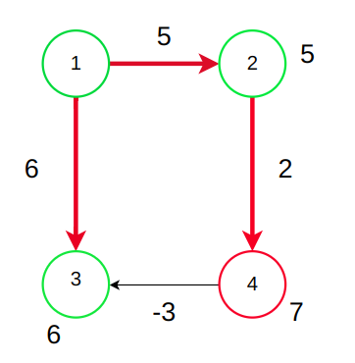
Limitation of Dijkstra
Might fail to find minimum distance in case of negative weights.
Example:
Dijkstra will not relax this edge because vertex 3 is already visited. But if it is checked, the distance of vertex 3 should become 7-3 = 4. So dijkstra cannot give correct answer in this case.

Slide 29
Limitation of Dijkstra
Might fail to find minimum distance in case of negative weights.
So, Dijkstra may or may not give the correct result for negative edge weights.
Solution: Bellman Ford

Slide 30
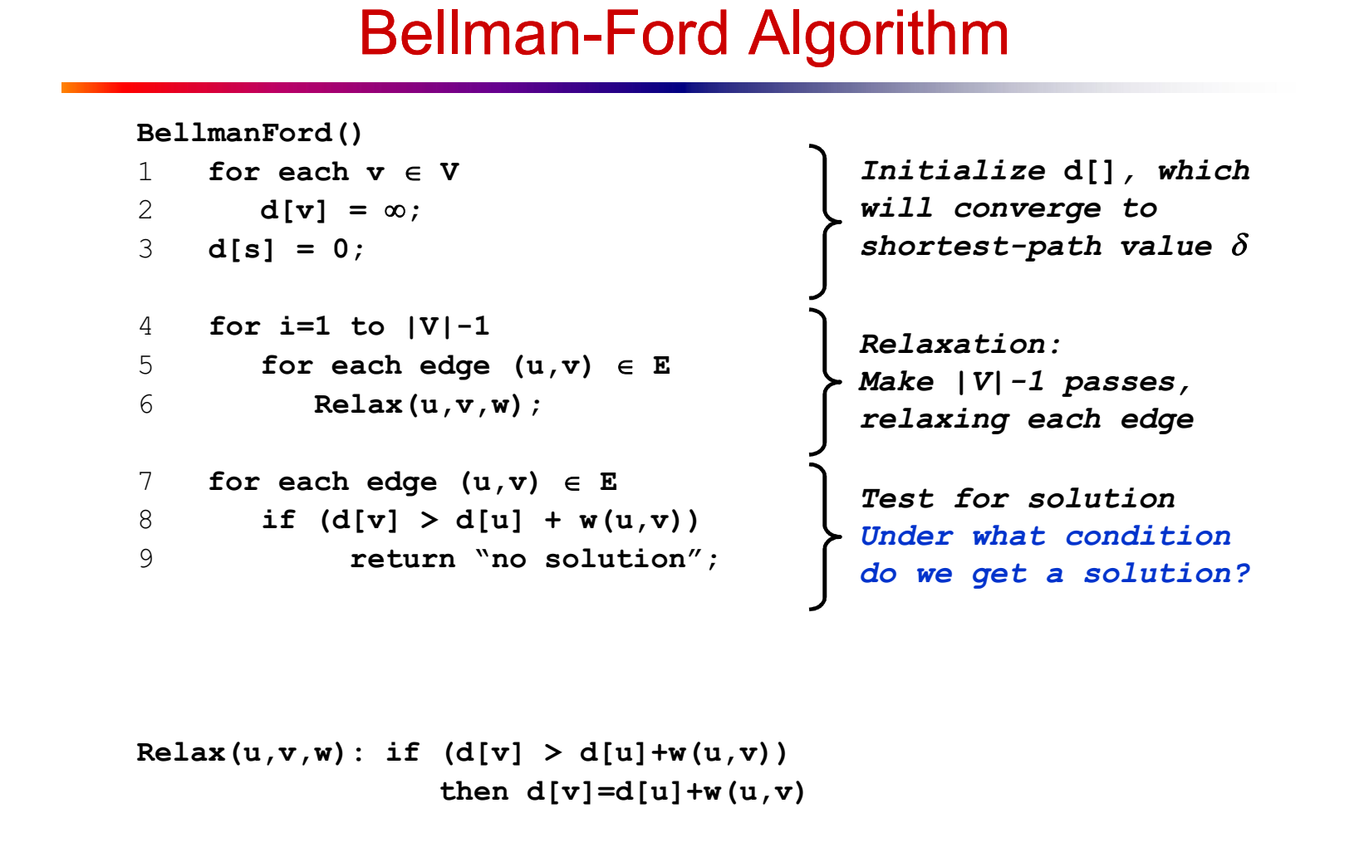
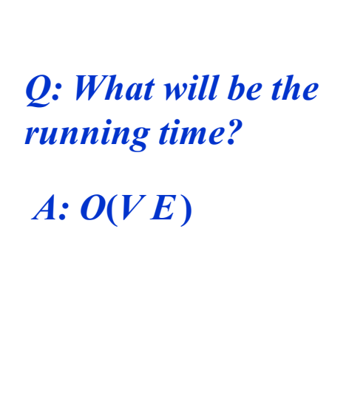

Slide 31
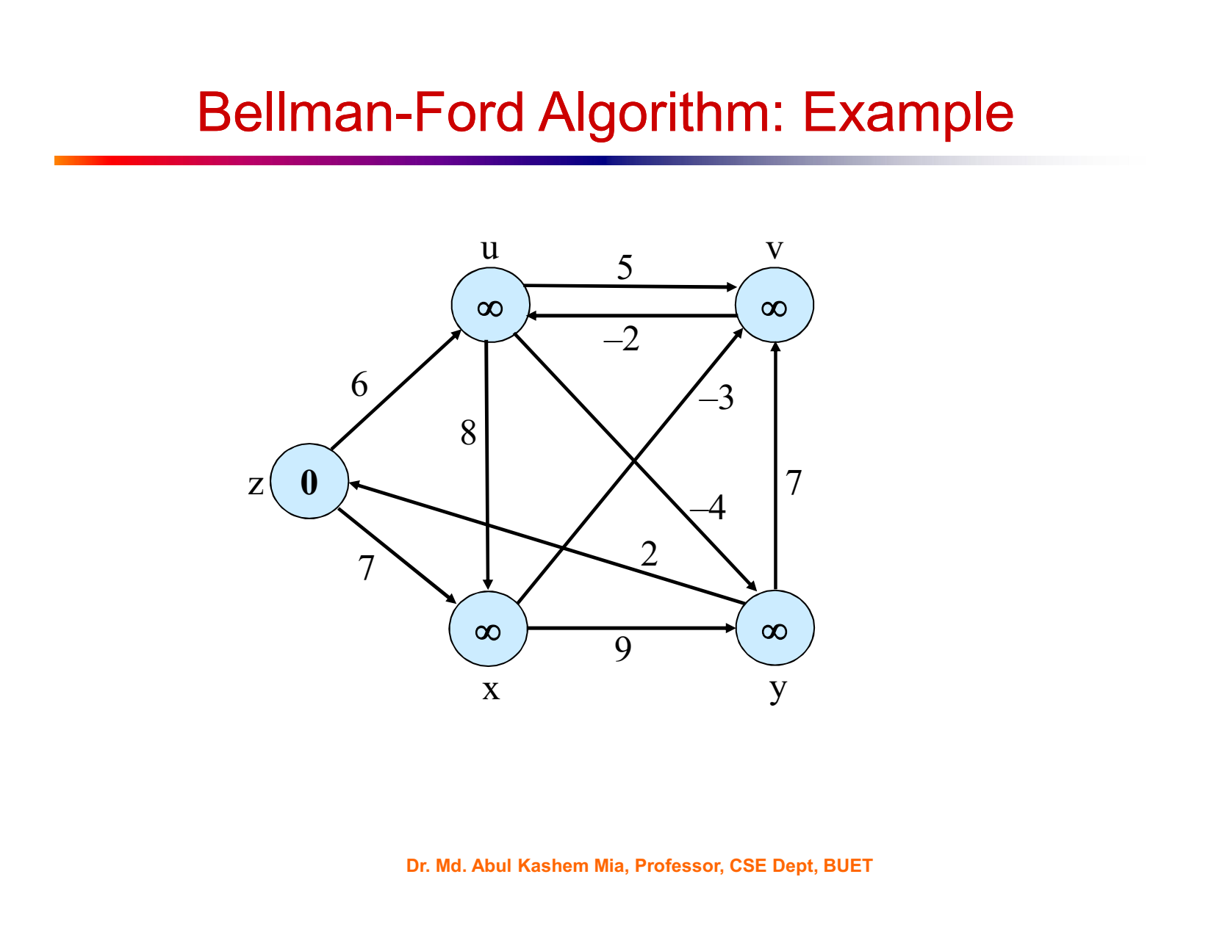
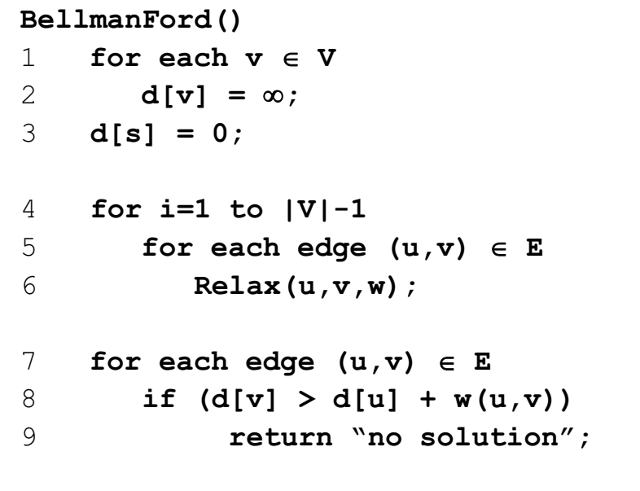

Slide 32
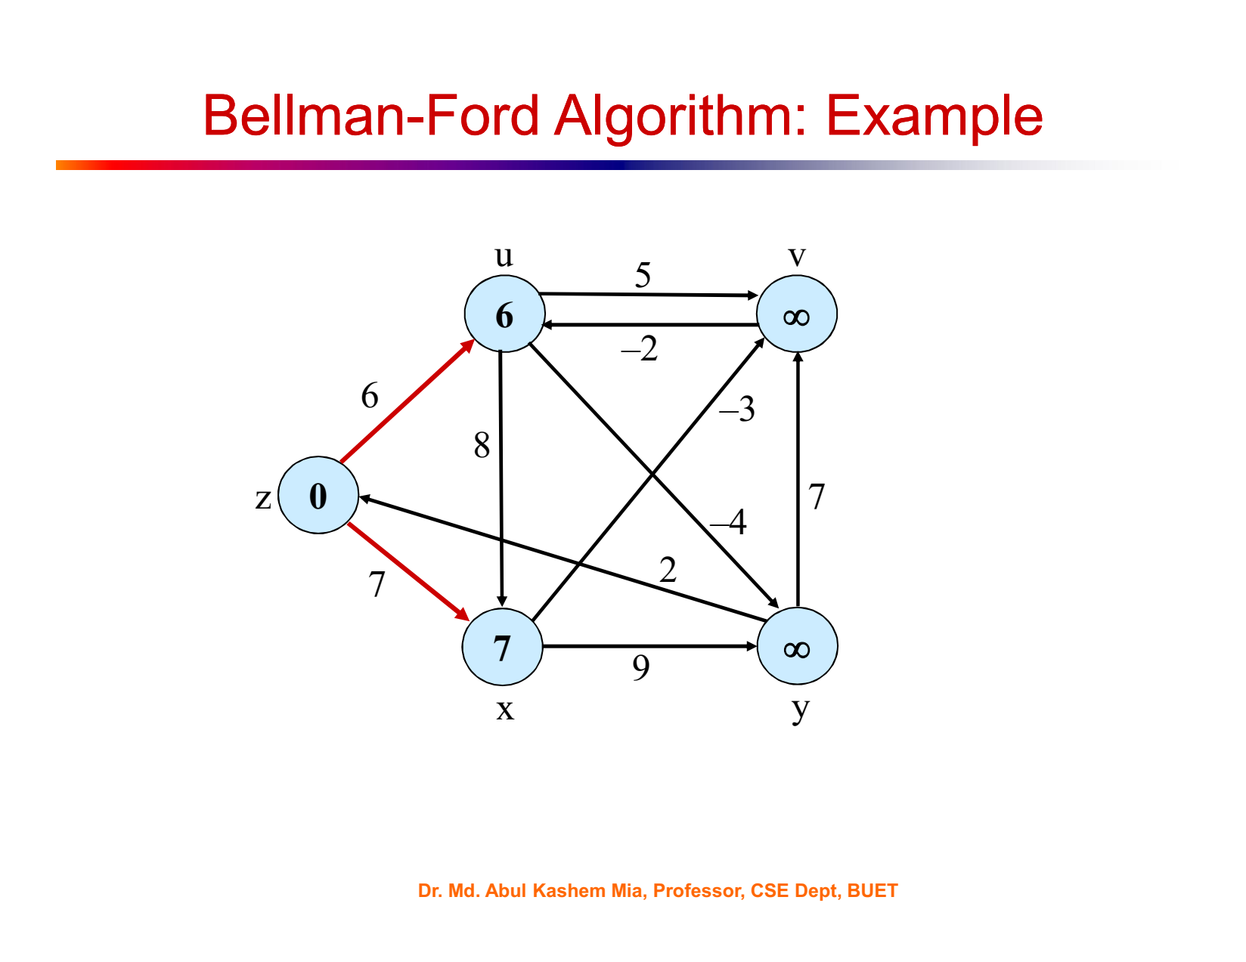

Slide 33
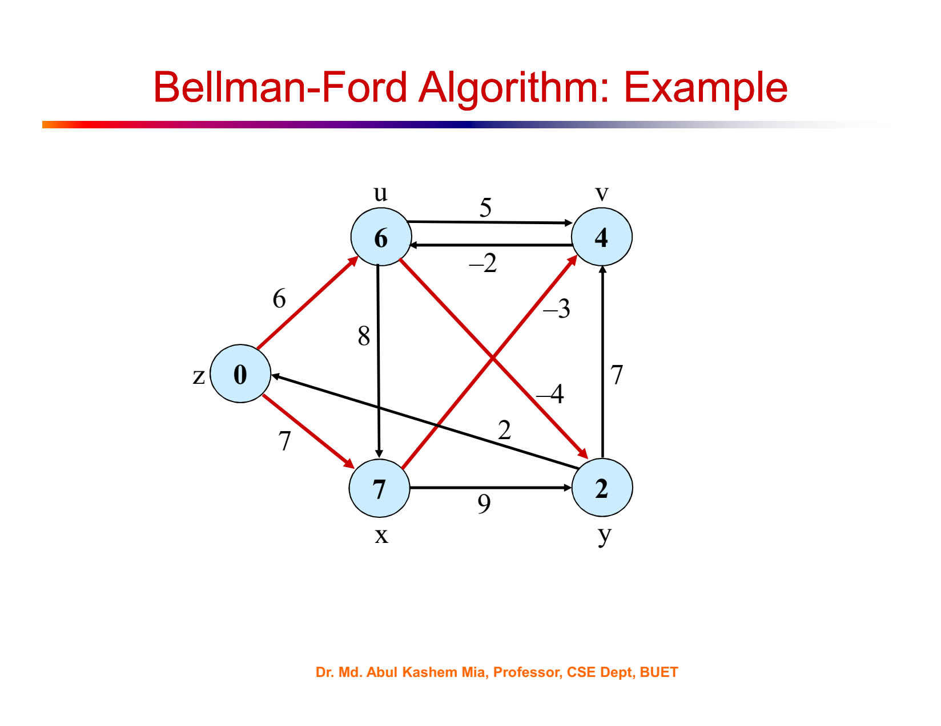

Slide 34
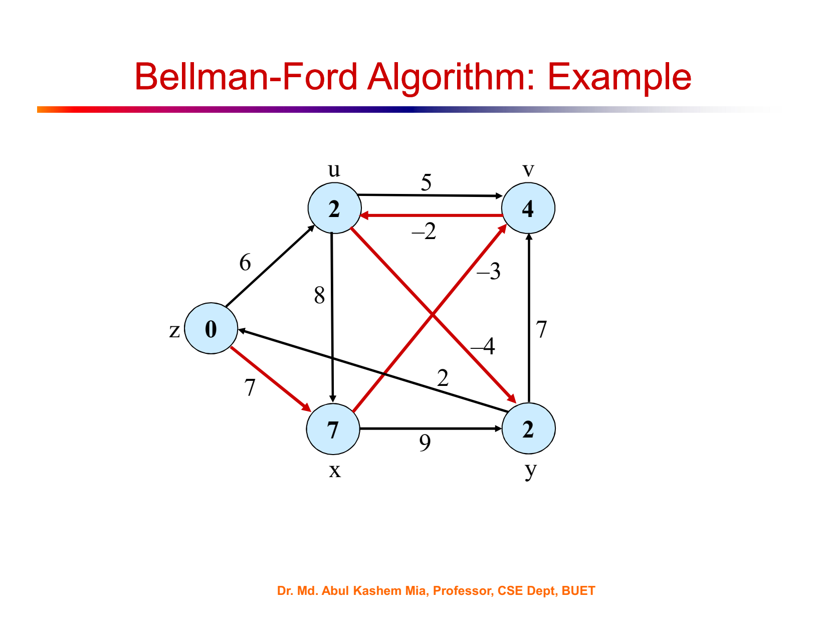

Slide 35


Slide 36
Limitation of Bellman Ford Algorithm
Cannot find shortest path for negative weight cycle.
After passing |V| - 1 times, there will still be some vertex, for which we did not yet reach the minimum distance. If we continue to run the algorithm again and again, it will keep decreasing. So, there will be no shortest path.

Slide 37
Limitation of Bellman Ford Algorithm
This additional checking finds out if there is any negative weight cycle and in this case, there will be no solution.

Slide 38
∞
3
∞
-6
2
0
∞
∞
1
3
u
v

Slide 39
1 pass complete out of 4 passes
|v|-1 = 5-1 = 4
∞
3
∞
-6
2
0
1
∞
1
3
u
v

Slide 40
-5
3
∞
-6
2
0
1
∞
1
3
u
v

Slide 41
2 passes complete out of 4 passes
|v|-1 = 5-1 = 4
-5
3
∞
-6
2
0
1
4
1
3
u
v

Slide 42
3 passes complete out of 4 passes
-5
3
-2
-6
2
0
1
4
1
3
u
v

Slide 43
4 passes complete out of 4 passes
-5
3
-2
-6
2
0
0
4
1
3
u
v

Slide 44
-5
3
-2
-6
2
0
0
4
1
3
u
v
0-6=-6 < -5

Slide 45
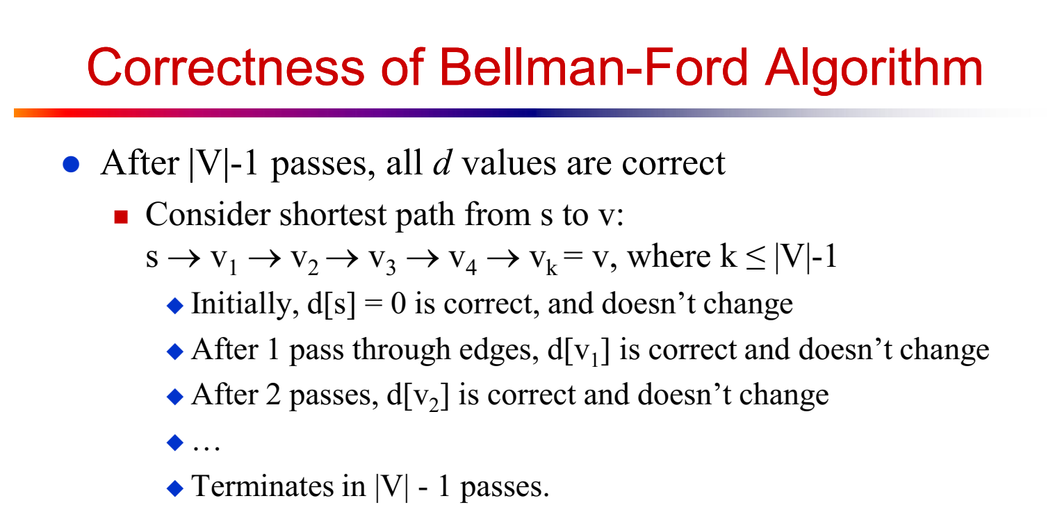

Slide 46
Time Complexity of Bellman Ford
→ Relax |E| edges for |V| - 1 times. So time complexity is O(|E|*(|V|-1)) = O(|E||V|) = O(n²).
→ If the graph is dense that means, if there are edges between all pairs of vertices, then |E| = n*(n-1)/2. SO the time complexity becomes O(n³).
Thus Bellman-Ford takes more time than dijkstra but it ensures the correct result.

Slide 47
Example usage of Bellman-Ford algorithm:
graph = {
'A': {'B': 1, 'C': 4},
'B': {'C': 2, 'D': 5},
'C': {'D': 1},
'D': {'B': -10}
}
start_vertex = 'A'
result = bellman_ford(graph, start_vertex)
print(result)
# Output: {'A': 0, 'B': -9, 'C': -8, 'D': -7}

Slide 48
Resources
3.6 Dijkstra Algorithm - Single Source Shortest Path - Greedy Method - YouTube
4.4 Bellman Ford Algorithm - Single Source Shortest Path - Dynamic Programming - YouTube

